Slide 1

CAFETERIA MANAGEMENT SYSTEM
Nikhil Malviya [17162101017]
Sne PaTEl [17162101029]
Vaghesh patel [17162101031]

Slide 2
INTRODUCTION
This project automates the task of ordering food in a café.
In this a user just have to create a user account and proceed further.
After creating account a user can login to their account and can look into some categories can buys some item.
He can see his transaction history and also can change there details
And there will be a admin account where all the details about the product can be changed or modified or can be deleted.

Slide 3
INTRODUCTION
This whole project will be developed in c++ with File management.
There will be login page for all users to enter into their accounts.
There will be also a admin login page where admin can add products and he can view all the details of every user.

Slide 4
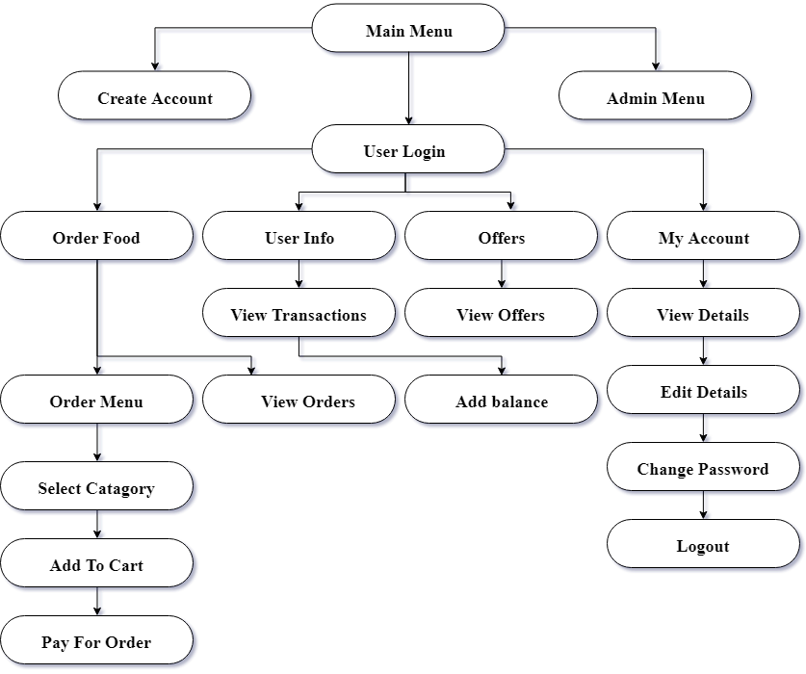
FLOW CHART

Slide 5
Requirements
Operating System ::: Windows XP/7/8/10
Platform ::: C++ language
IDE ::: CodeBlocks
RAM ::: 512 MB

Slide 6
CLASSES USED
UserData
Product
StartPage
Login
MainMenu
CreateAccount
System
Menu
OrderMenu
Order
Transaction
TextEffects
Shape
Widget
TextArt
Time
Admin

Slide 7
ScreenShots

Slide 8
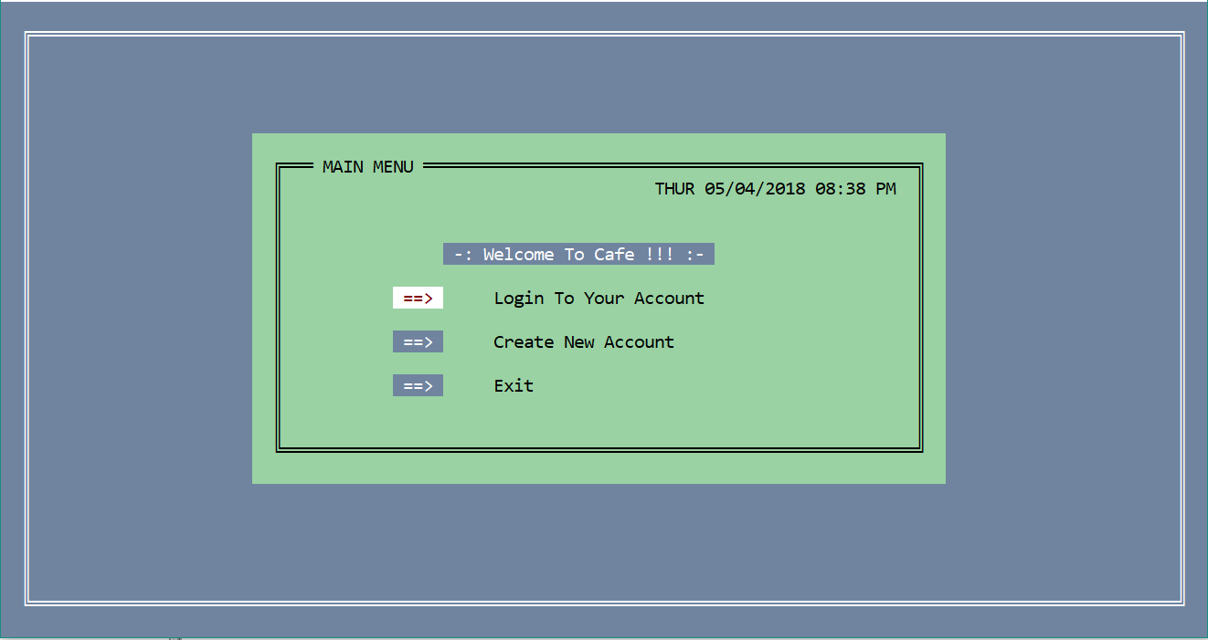
Main Menu

Slide 9
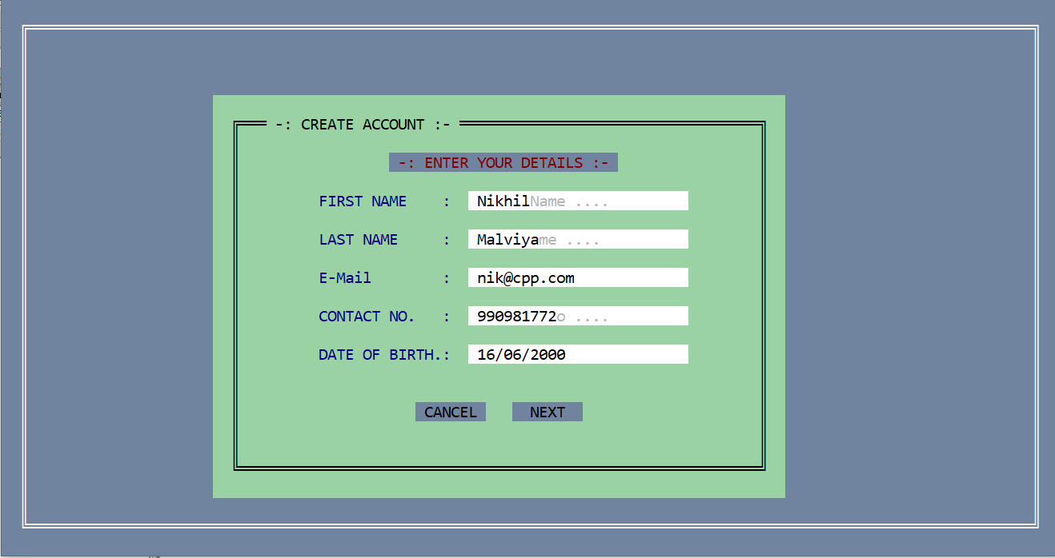
Create Account

Slide 10
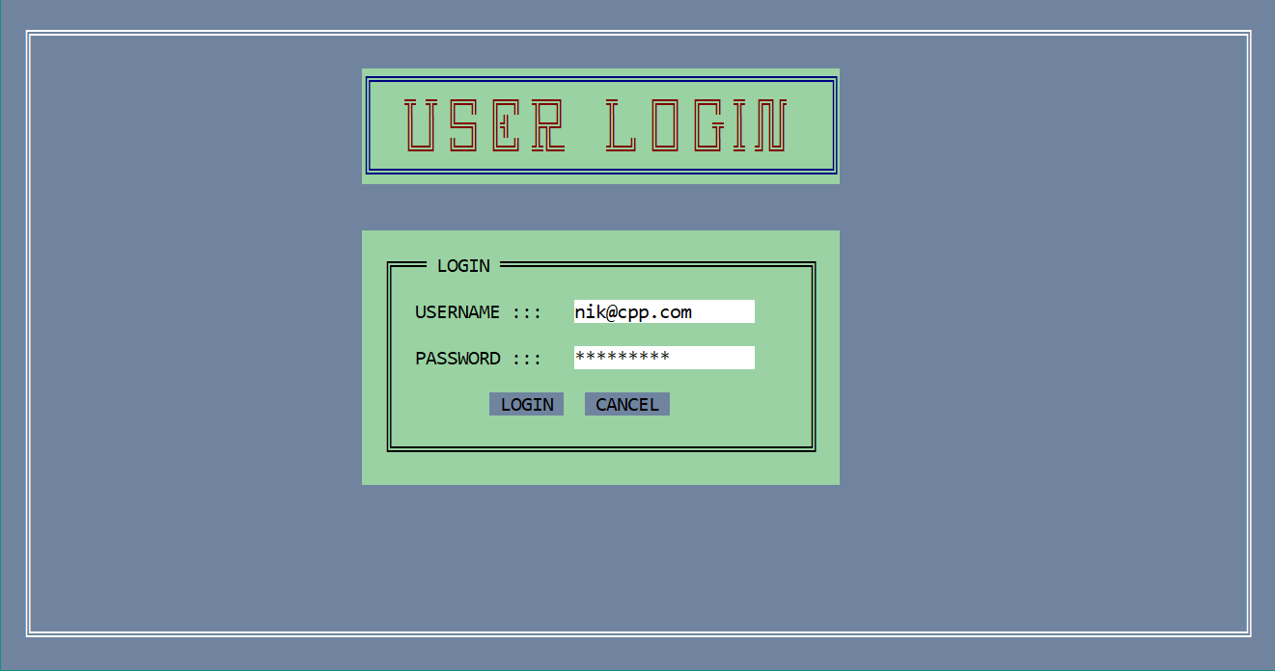
User Login

Slide 11
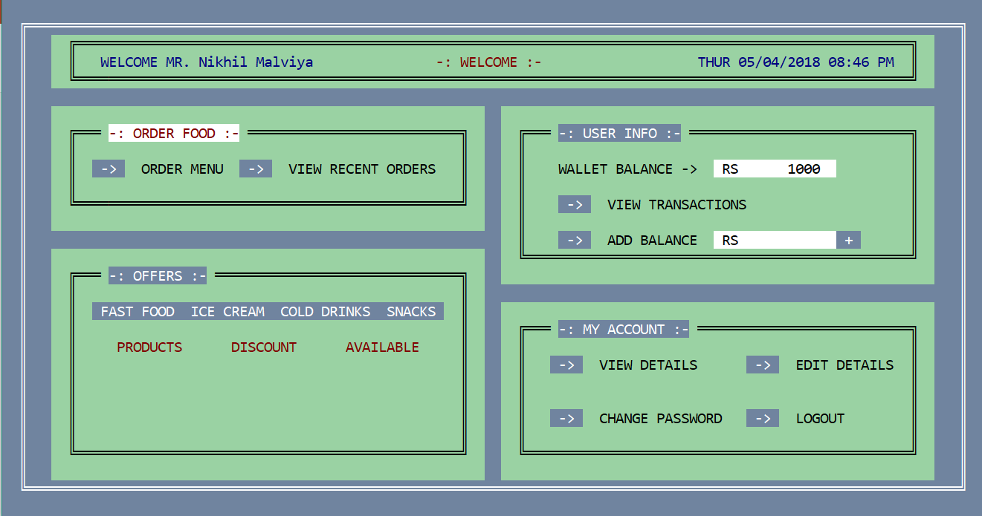
Menu

Slide 12
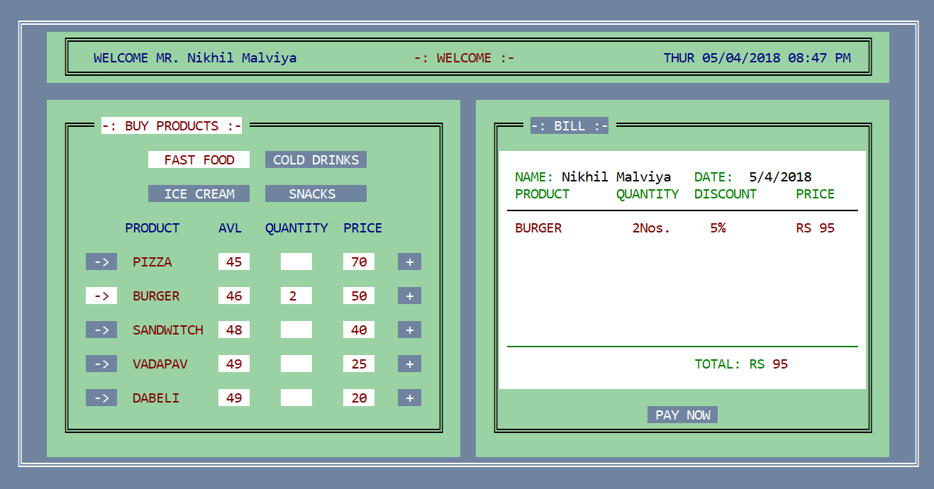
Order Menu

Slide 13
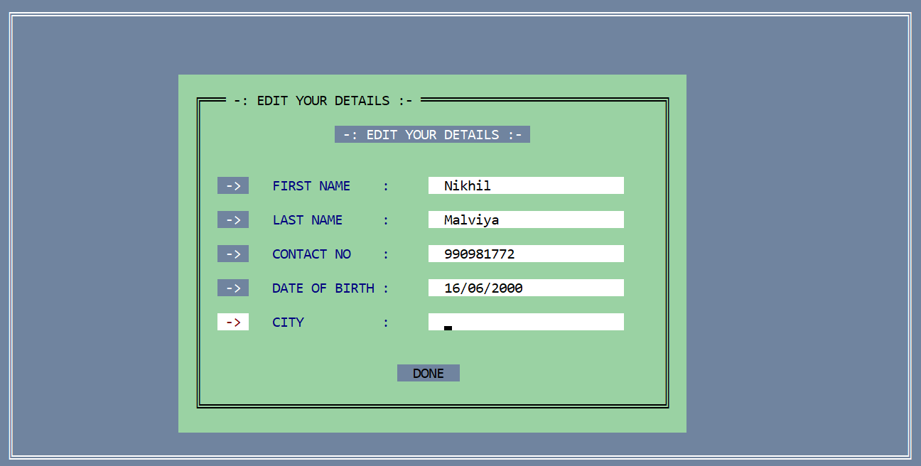
Edit Details

Slide 14
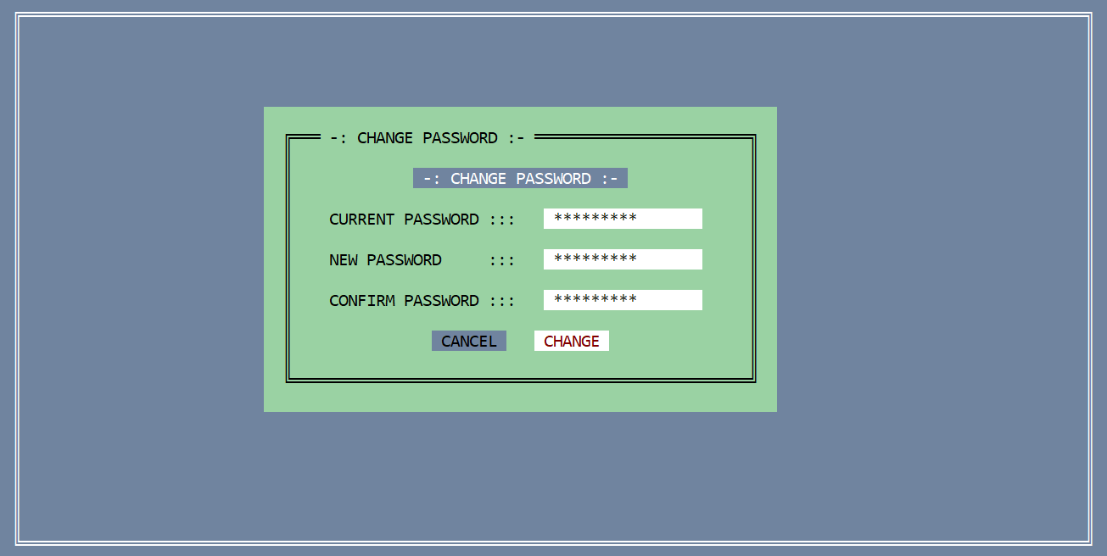
Change Password

Slide 15
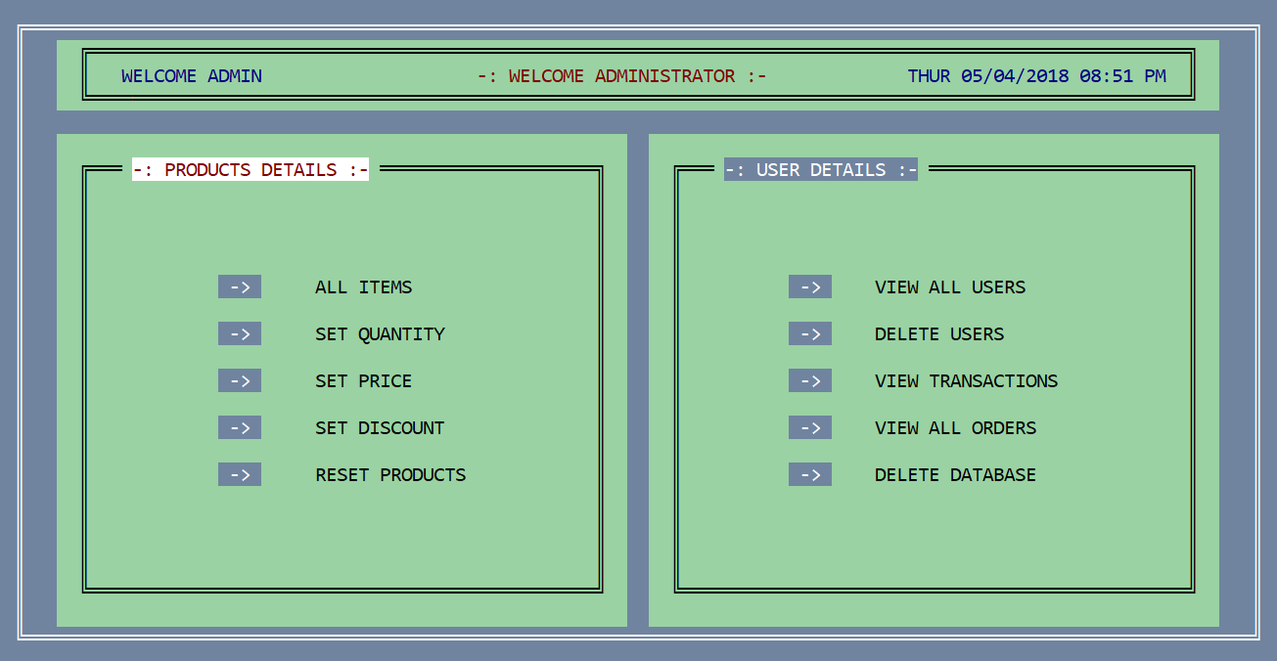
Admin Menu

Slide 16
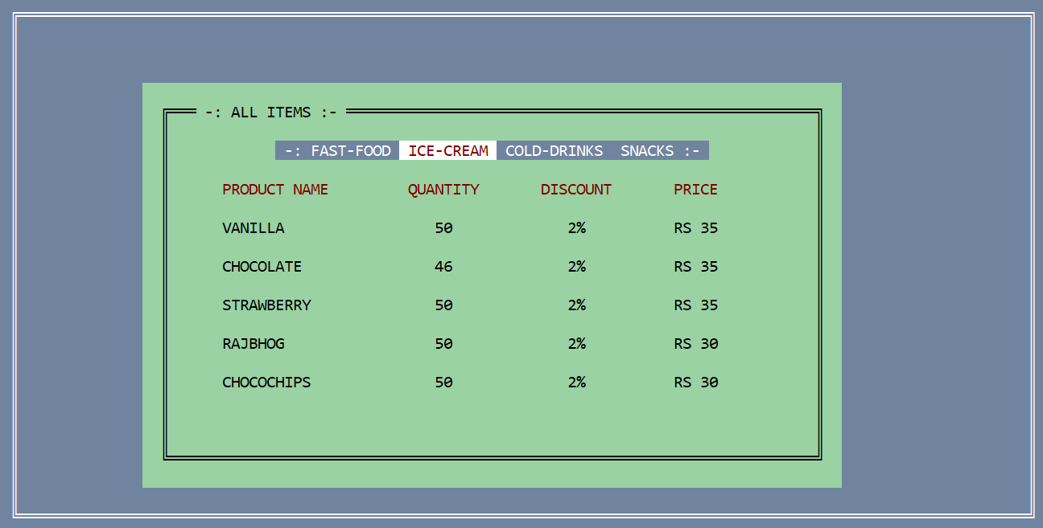
View All Items - Admin

Slide 17
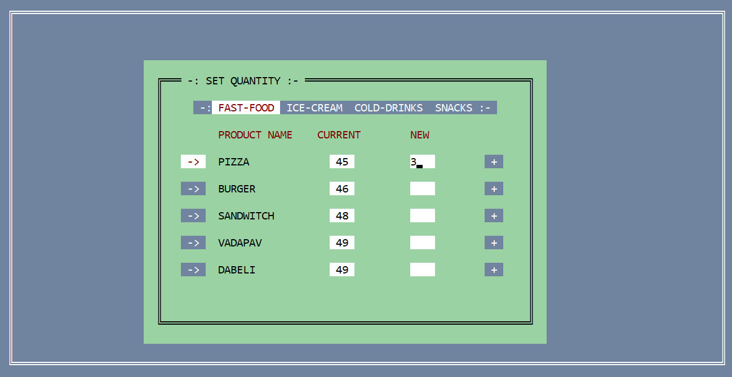
Modify Products

